Slide 1
CLOUD COMPUTING
-DHIRAJ WADILE
SE 11-G11
23361

Slide 2
CONTENTS
INTRODUCTION
WHAT IS CLOUD?
WHAT IS CLOUD COMPUTING?
DEPLOYMENT MODELS
SERVICE MODELS

Slide 3
INTRODUCTION:
applications: utilities over the internet.
Allows us to create, configure and customize applications online.
Access database resources via internet from internet.

Slide 4
WHAT IS CLOUD?
NETWORK or INTERNET.
Present at remote location, provides service over network ,i.e., on public or private network.
E-mails, Web conferencing , customer relationship management(CRM).

Slide 5
CLOUD COMPUTING
manipulating, accessing and configuring the applications online.
Combination of both hardware and software.
Online data storage, infrastructure and application.

Slide 6
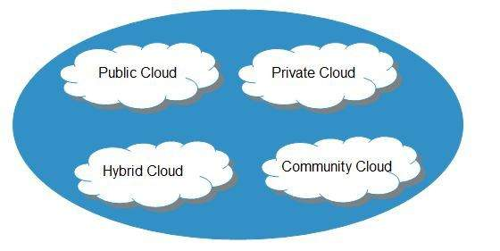
DEPLOYMENT MODELS

Slide 7
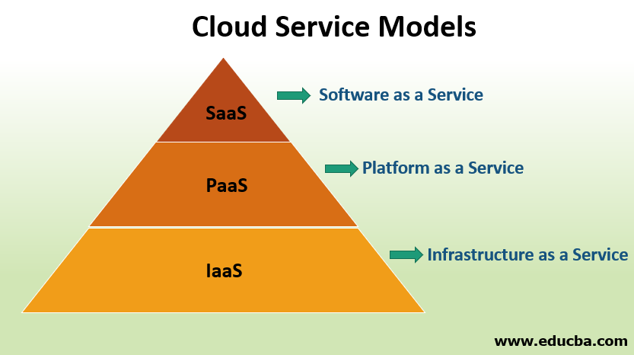
SERVICE MODELS

Slide 8
REFERENCES :- https://azure.microsoft.com

Slide 9
THANK YOU

